Slide 1
Mobile Agents in Wireless Sensor Networks
Ivan Vukasinovic
Zoran Babovic
Goran Rakocevic

Slide 2
Mobile Agents
Mobile agents are a form of processes with the following characteristics:
Mobile – able to migrate from a device to a device and execute
Inteligent – able to react to the environment changes
Autonomous – work completely without interaction with the creator
Ability to move around in a network of devices, computers, makes them very useful
Working MA migrates around the network
Executes its code to accomplish the given job
Platform support is needed:
Agila – Assembler like code
ActorNet – Special for Mica2/ TinyOS
MAPS – Mobile Agent platform for Sun S.P.O.T.s
AFME – Open source lightweight J2ME platform

Slide 3
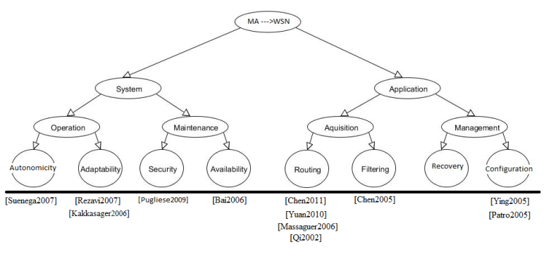
Classification Tree
Autonomicity - ability to work autonomously.
Security – upgrading security for WSN.
Adaptability – ability to adapt to new circumstances.
Availability – improving availability to the user.
Routing - routing in WSN during data acquisition.
Filtering – excluding junk data during acquisition.
Recovery – maintaining functioning minimum.
Configuration - setting specific configurations.

Slide 4
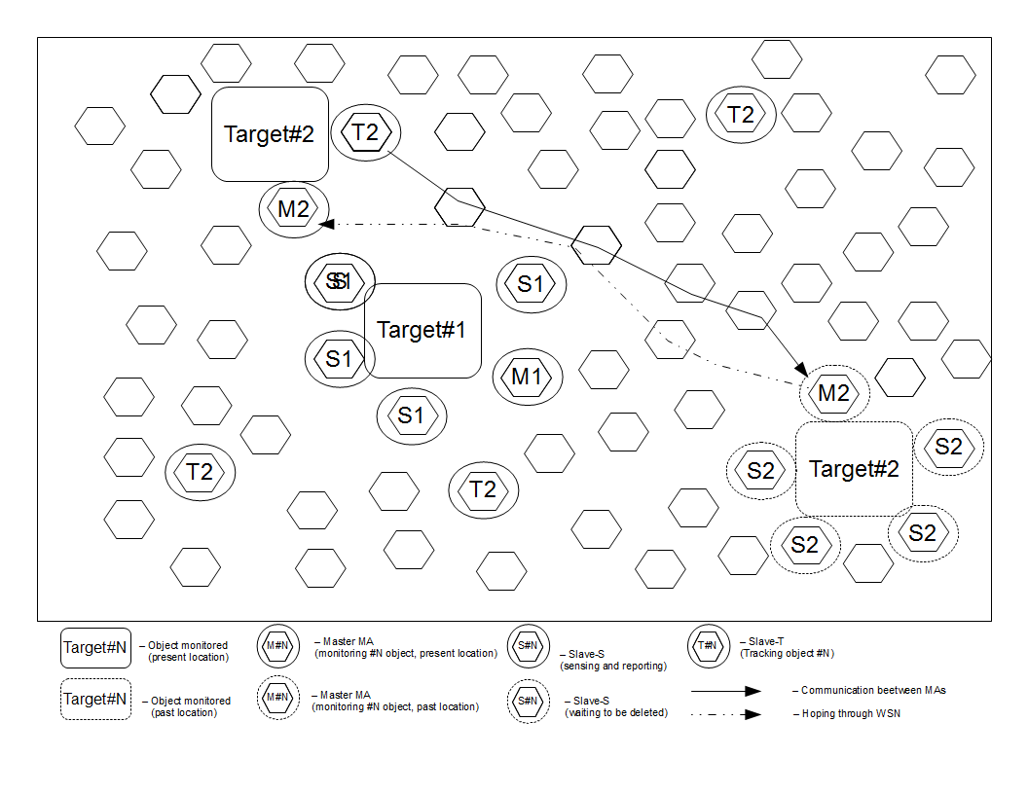
Autonomicity “ Constructing Locally Centralized Applications by Mobile Agents in Wireless Sensor Networks “
GOAL: Mobile targets tracking and monitoring applications
IDEA: Grouping MAs to form a central monitoring function

Slide 5
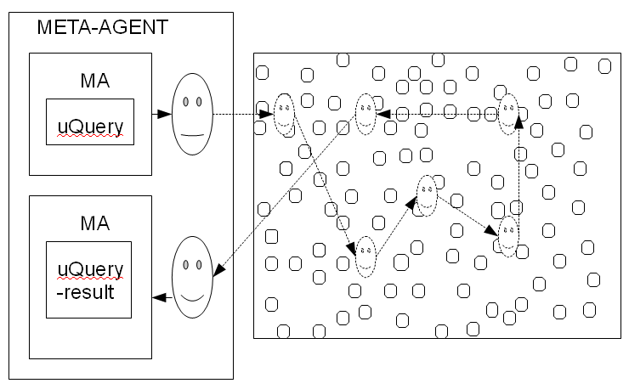
Adaptability "Dynamic Macro-programming of Wireless Sensor Networks with Mobile Agents “
GOAL: Enable diverse functionality of WSNs by enabling Queries
IDEA: Representing them with mobile agents

Slide 6
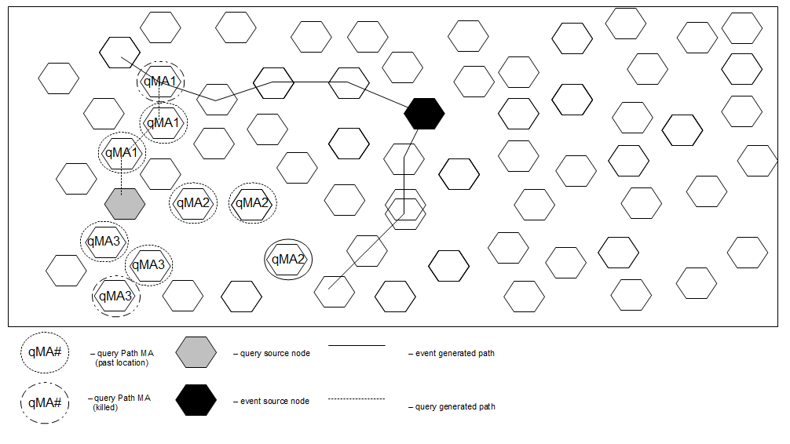
Adaptability “ Mobile Agent based event discovery in Wireless Sensor Networks "
GOAL: Upgrading query distribution and event responsiveness using event paths generated by MAs
IDEA: MAs hop through the network updating and fixing optimum paths

Slide 7
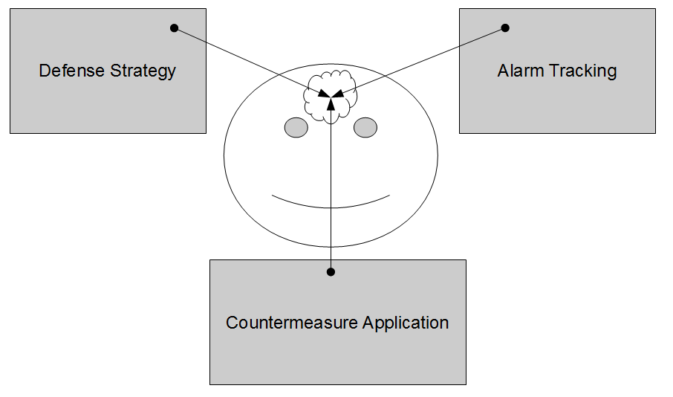
Security “ Agent-based Scalable Design of a Cross-Layer Security Framework for Wireless Sensor Networks Monitoring Applications ”
GOAL: Designing a framework for WSNs with needed security level in WSNs
IDEA : Agents are integrated with the code for developing intrusion detection as well as intrusion detected reaction.

Slide 8
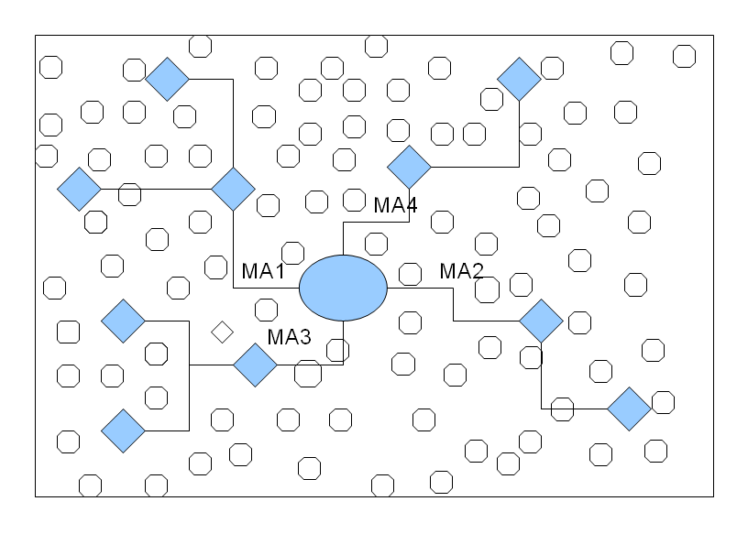
Routing “ Balanced Itinerary Planning for Multiple Mobile Agents in Wireless Sensor Networks ”
GOAL: reducing power consumption and thereby increasing the networks lifetime
IDEA: generate the appropriate number of agents which is equal to vertices coming out of the root of the balanced spanning tree.

Slide 9
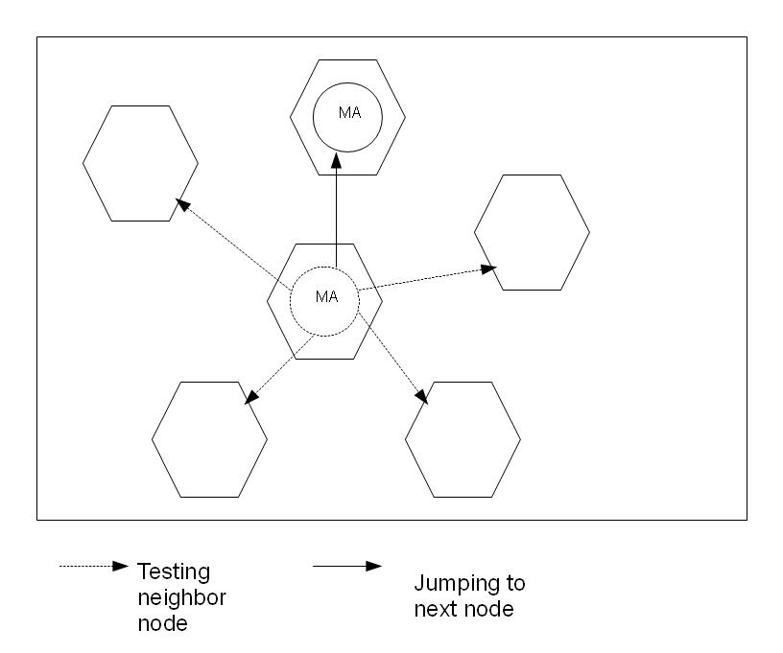
Routing “ A Data Gathering Algorithm Based on Mobile Agent and Emergent Event-Driven in Cluster-Based WSN “
GOAL: Mobile agents gather sensor data from all nodes within a cluster
IDEA: Mobile agent calculates the next hop node taking into consideration the power consumption, path loss and residual energy

Slide 10
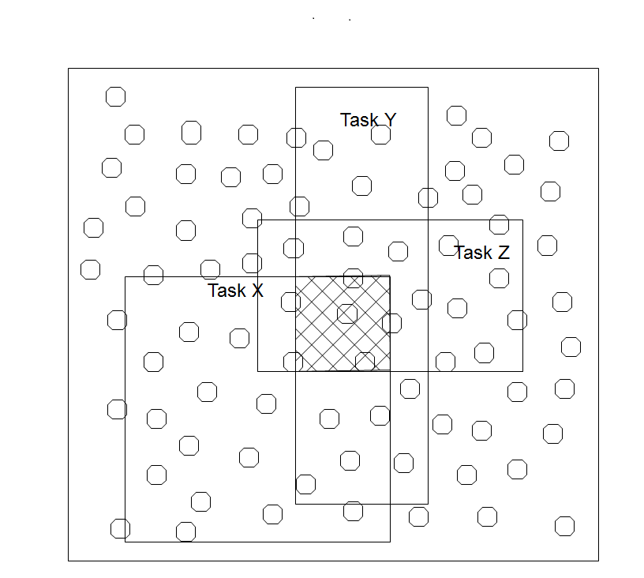
Filtering “ Data Dissemination based on Mobile Agent in Wireless Sensor Networks “
GOAL: Decrease the total amount of data needed for gathering
IDEA: Aggregate resulting data into combined task of sensor overlapping in areas of individual tasks

Slide 11
Recovery
An empty slot for Mendelevisation which will include our future research
An approach to use Mobile Agent to pursue recovery from node failure, etc.

Slide 12
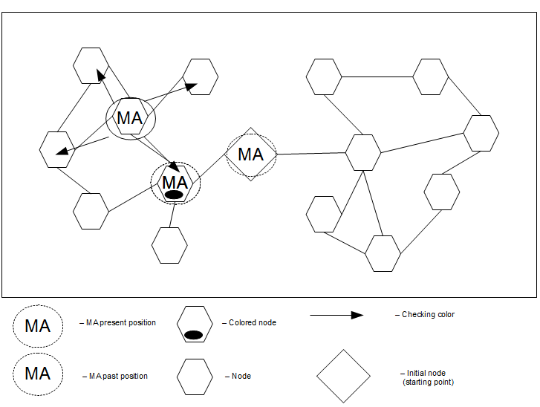
Configuration “ Mobile Agent Based TDMA Slot Assignment Algorithm for Wireless Sensor Networks “
GOAL: TDMA slot assignment in WSNs
IDEA: MA traversing all the nodes and assigning them a neighbor unique slot

Slide 13
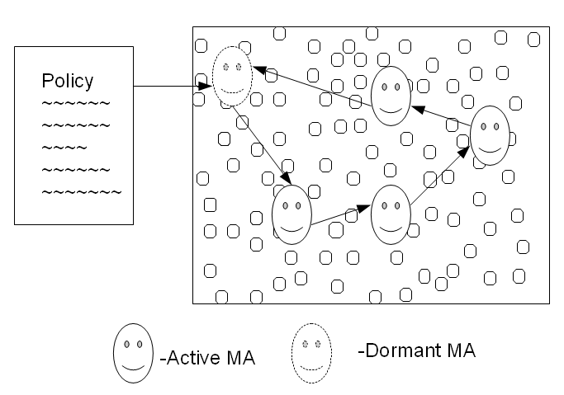
Configuration “ Mobile Agent-based Policy Management for Wireless Sensor Networks ”
GOAL: Policy management on the sensor nodes
IDEA: Policy is executed by a mobile agent residing in the WSN

Slide 14
Summary: Global conclusion
Strengthening WSNs weaknesses using strengths of the MA technology
Most target power consumption
Others try to extend the functionality
Many of them open new discussions and topics, for further research.

Slide 15
Mobile Agents in Wireless Sensor Networks
QUESTIONS ???
A full survey paper can be sent via email:
Ivan Vukasinovic, email: ivanvuk88etf@gmail.com
Goran Rakocevic, email: g.rakocevic@gmail.com
Zoran Babovic, email: zbabovic@gmail.com

